Slide 1
An Introduction to Algorithm
Mehnuma Tabassum Omar
Assistant Professor
Dept. of CSE
KUET

Slide 2
OBJECTIVES
Understand the concept of an algorithm.
Define and use the three constructs for developing algorithms: sequence, decision, and repetition.
Understand and use three tools to represent algorithms: flowchart, pseudocode, and structure chart.
Understand the concept of modularity and subalgorithms.

Slide 3
CONCEPT

Slide 4
Algorithms
Algorithm comes from the name of a Persian mathematician Abu Ja’far Mohammed ibn-i Musa al Khowarizmi.
A special method useable by a computer for solution of a problem.
The statement of the problem specifies in general terms the desired input/output relationship.
For example, sorting a given sequence of numbers into nondecreasing order provides fertile ground for introducing many standard design techniques and analysis tools.

Slide 5
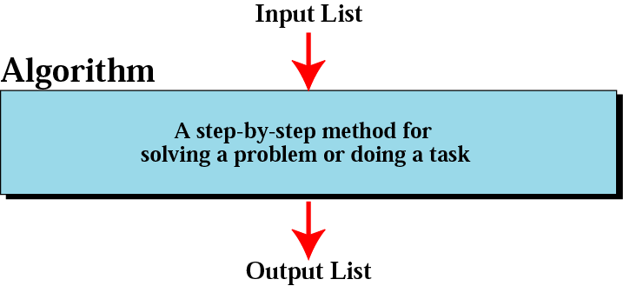
Informal definition of an algorithm
used in a computer

Slide 6
Criteria of an Algorithm
Input
0 or more quantities are externally supplied
Output
At least 1 quantity is produced
Definiteness
Each instruction is clear and ambiguous
Finiteness
Terminates at a finite number of states
Effectiveness
Instruction must be basic to carry out principle

Slide 7
Area of study
How to devise an Algorithm
Study various techniques
How to validate an Algorithm
Show that it computes the correct answer for all possible legal input.
How to analyze an Algorithm
Time complexity
Space complexity
How to test a program
Debugging
Profiling

Slide 8
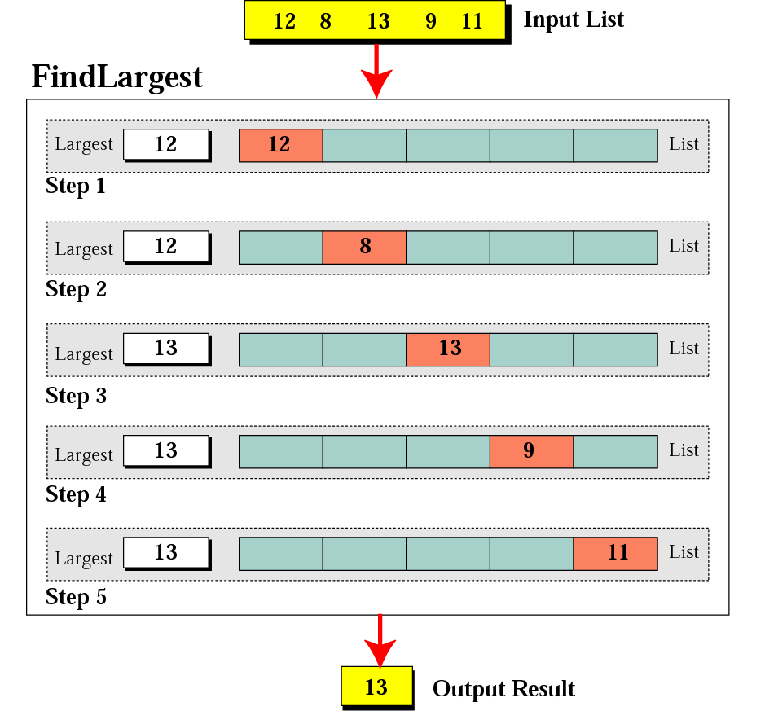
Finding the largest integer among five integers

Slide 9
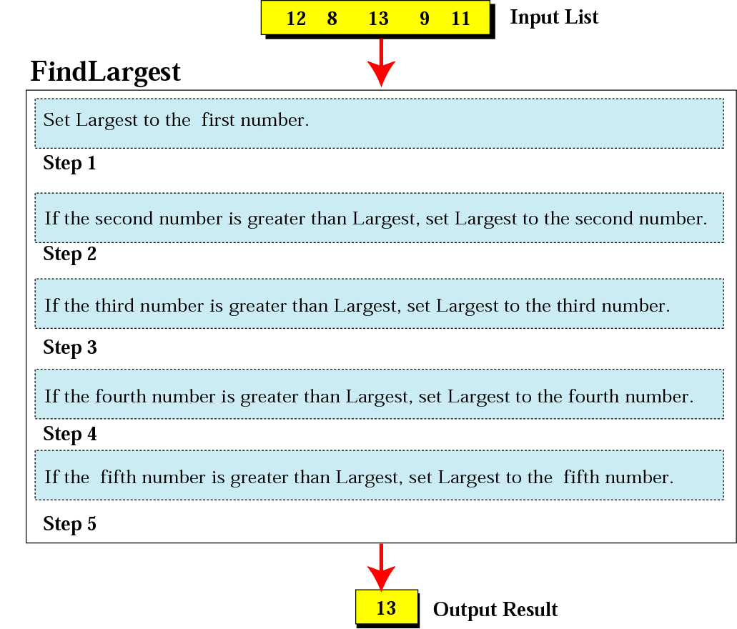
Defining actions in FindLargest algorithm

Slide 10
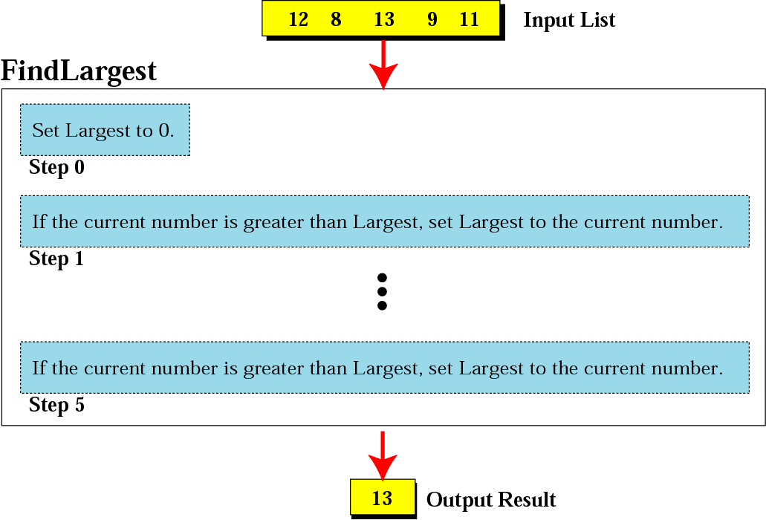
FindLargest refined

Slide 11
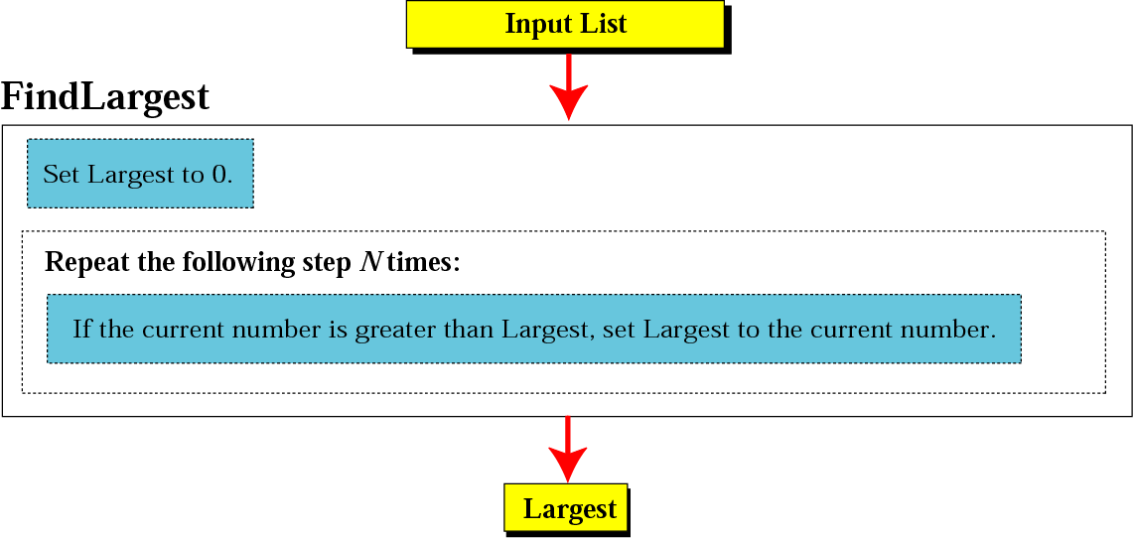
Generalization of FindLargest

Slide 12
THREE CONSTRUCTS

Slide 13
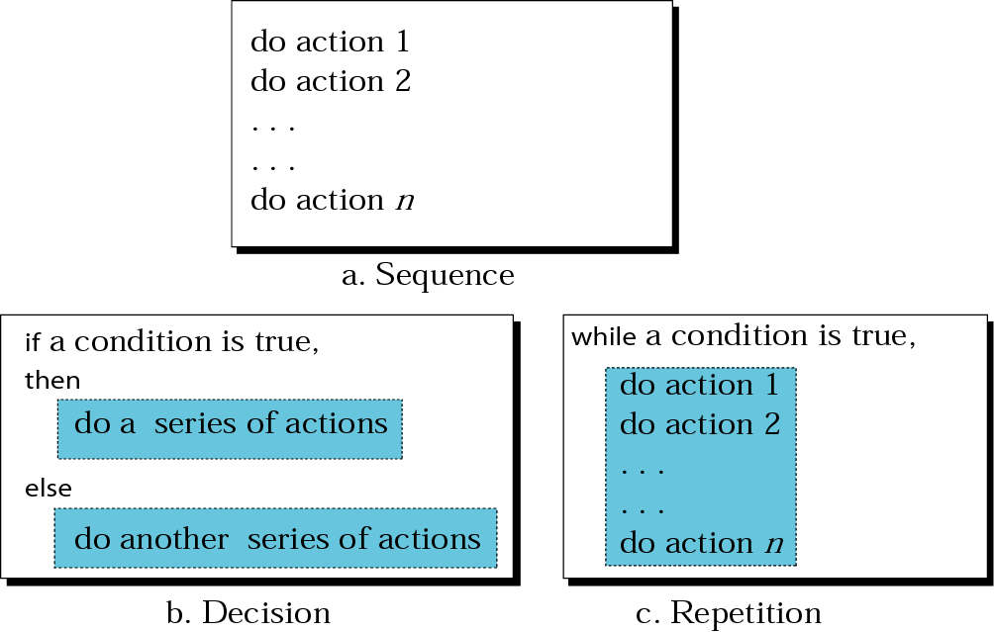
Three constructs

Slide 14
ALGORITHM
REPRESENTATION

Slide 15
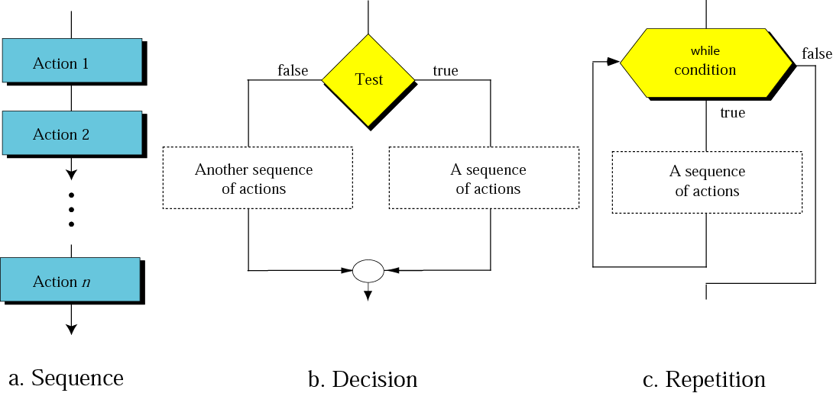
Flowcharts for three constructs

Slide 16
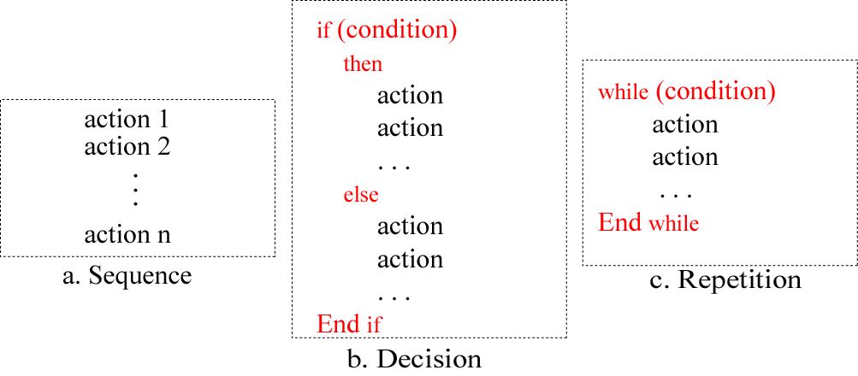
Pseudocode for three constructs

Slide 17
Example 1
Write an algorithm in pseudocode that finds the average of two numbers

Slide 18
Solution:
Average of two
AverageOfTwo
Input: Two numbers
Add the two numbers
Divide the result by 2
Return the result by step 2
End

Slide 19
Example 2
Write an algorithm to change a numeric grade to a pass/no pass grade.

Slide 20
Solution:
Pass/no pass Grade
Pass/NoPassGrade
Input: One number
if (the number is greater than or equal to 70) then
1.1 Set the grade to “pass”
else
1.2 Set the grade to “nopass”
End if
Return the grade
End

Slide 21
Example 3
Write an algorithm to find the largest of 1000 numbers.

Slide 22
Solution:
Find largest of 1000 numbers
FindLargest
Input: 1000 positive integers
Set Largest to 0
Set Counter to 0
while (Counter less than 1000) 3.1 if (the integer is greater than Largest) then 3.1.1 Set Largest to the value of the integer End if 3.2 Increment Counter End while
Return Largest
End

Slide 23
SUBALGORITHMS

Slide 24
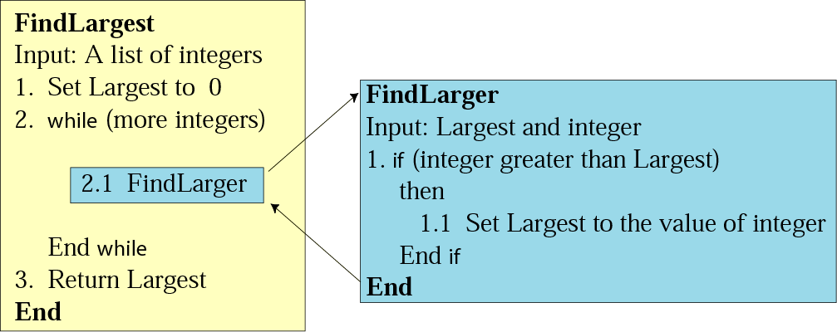
Figure 8-9
Concept of a subalgorithm

Slide 25
Find largest
FindLargest
Input: A list of positive integers
Set Largest to 0
while (more integers) 2.1 FindLarger End while
Return Largest
End

Slide 26
Subalgorithm:
Find larger
FindLarger
Input: Largest and current integer
if (the integer is greater than Largest) then 1.1 Set Largest to the value of the integer End if End

